Slide 1
Relational database (tables, DBMS and SQL)
Name | StudentId | CourseId
David | S4 | C1
Cindy | S3 | C3
Jeff | S1 | C1
Mike | S2 | C1
Anne | S1 | C2
Most world’s data kept in relational database (including Google, Facebook Amazon)
Tables, DBMS and SQL in relational database
Data organized into one or more tables (or "relations") of columns and rows, with a unique key identifying each row
There are many commercial systems, such as Microsoft SQL server, Oracle database…..

Slide 2
Anatomy of a Relational database
StudentId | Name | CourseId
S1 | Anne | C1
attribute name
attribute values
Records, n-tuple, or tuple. The tuples constitute the body of the relation.
Heading (a set of attributes) The degree of this heading is 3,
which is also the degree of the relation.
Each row in a table has its own unique key. Rows in a table can be linked to rows in other tables by adding a column for the unique key of the linked row (such columns are known as foreign keys).

Slide 3
Relational database
Name | StudentId | CourseId
David | S4 | C1
Cindy | S3 | C3
Jeff | S1 | C1
Mike | S2 | C1
Anne | S1 | C2
This organizes data into one or more tables (or "relations") of columns and rows, with a unique key identifying each row

Slide 4
Relational database
Name | StudentId | CourseId | Name
David | S4 | C1
Cindy | S3 | C3
Jeff | S1 | C1
Mike | S2 | C1
Anne | S1 | C2
Anne | S1 | C2
A unique key identifying each record(row). The key can be a single attribute or combinations.

Slide 5
Consider this table: can this be a table in relational database?
Three mistakes:
A | B | A
1 | 2 | 3
4 |  | 5
6 | 7 | 8
9 | 9 | ?
1 | 2 | 3

Slide 6
Attribute
Attribute data type: – Text: VARCHAR(20) – Integer: INTEGER – Floating-point: FLOAT, DOUBLE – Date/time DATE, TIME, DATETIM
Attribute value
Record
Primary key: provides a unique identifier for each row (optional).
Schema: the structure of the database tables
– The table name
– The names and types of its attribute (columns)
– Various optional additional information (defaults, constraints, etc.)
Database Management System (DBMS): a software that is used to create, access, and maintain a database; e.g., SQLite, MySQL, PostgreSQL, Oracle, SQL server.

Slide 7
One-to-One Relationship
Table A
Table B
Record 1
Record 2
Record 3
Record 4
Record 1
Record 2
Record 3
Record 4

Slide 8
One-to-Many Relationship
Table A
Table B
Record 1
Record 2
Record 3
Record 4
Record 1A
Record 1B
Record 1C
Record 2A
Record 2B
Record 3A
Record 3B
Record 3C
Record 3D
Record 4A
Record 4B

Slide 9
Not Many-to-Many Relationship
Table A
Table B
Record 1
Record 2
Record 3
Record 4
Record 1A
Record 1B
Record 1C
Record 2A
Record 2B
Record 3A
Record 3B
Record 3C
Record 3D
Record 4A
Record 4B

Slide 10
Many Tables Can Be Linked
Table A
Table B
Table D
Table C
Lookup
Table E

Slide 11
Database Management System (DBMS)
A database management system (DBMS) is system software for creating and managing databases. A DBMS makes it possible for end users to create, read, update, delete data and search the data in a database. The most prevalent type of data management platform, the DBMS essentially serves as an interface between databases and end users or application programs, ensuring that data is consistently organized and remains easily accessible.
DB Browser for SQLite
https://sqlitebrowser.org/
SQL = “Structured Query Language”

Slide 12
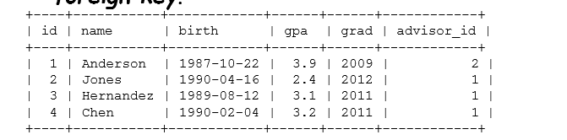
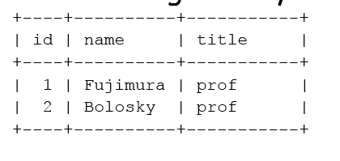
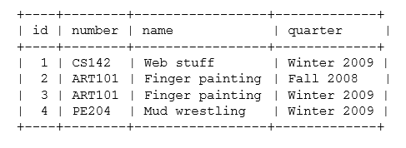
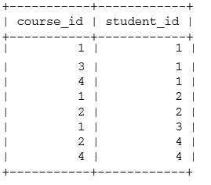
Establish a new database and Create the tables
students
advisors
courses
Courses_students

Slide 13
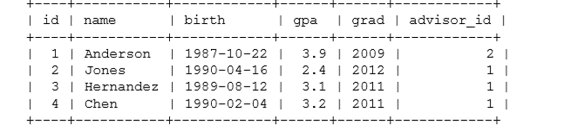
SQL = “Structured Query Language”
Universal for all relational databases
Open the DB Browser
Establish a new database “students” (click on the “New database”).
Click cancel. Let’s execute the SQL to create tables, click on the “Execute SQL”
Create a table for the students:
CREATE TABLE students ( id INTEGER PRIMARY KEY, name VARCHAR(30), birth DATE, gpa FLOAT, grad INTEGER );
Drop table:
DROP TABLE students;
Four main types of queries:
Insert, Delete, Select, Update

Slide 14
Insert/Delete
Add rows to the students table:
INSERT INTO students(name, birth, gpa, grad) VALUES ('Anderson', '1987-10-22', 3.9, 2009);
INSERT INTO students(name, birth, gpa, grad) VALUES ('Jones', '1990-4-16', 2.4, 2012);
INSERT INTO students(name, birth, gpa, grad) VALUES ('Hernandez', '1989-8-12', 3.1, 2011);
INSERT INTO students(name, birth, gpa, grad) VALUES ('Chen', '1990-2-4', 3.2, 2011);
Delete row(s):
DELETE FROM students;

Slide 15
Exercise 1 (Establish a database named as students)
Create the 4 tables, insert the values. Show the SQL statements and screenshots of the tables
students
advisors
Courses_students
courses

Slide 16
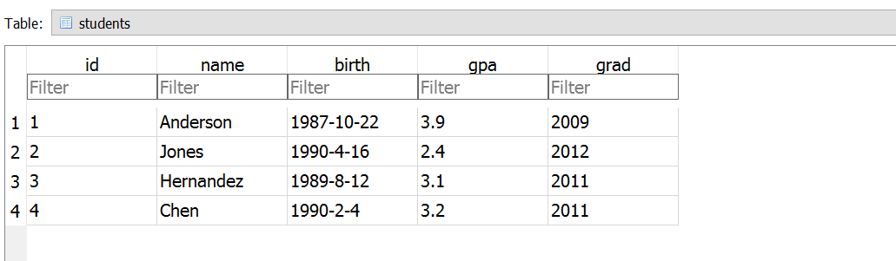
Establish a new database and Create the tables
Create the other three tables, insert the values. Show the SQL statements and screenshots of the tables
CREATE TABLE students ( id INTEGER PRIMARY KEY, name VARCHAR(30), birth DATE, gpa FLOAT, grad INTEGER );
INSERT INTO students(name, birth, gpa, grad) VALUES ('Anderson', '1987-10-22', 3.9, 2009);
INSERT INTO students(name, birth, gpa, grad) VALUES ('Jones', '1990-4-16', 2.4, 2012);
INSERT INTO students(name, birth, gpa, grad) VALUES ('Hernandez', '1989-8-12', 3.1, 2011);
INSERT INTO students(name, birth, gpa, grad) VALUES ('Chen', '1990-2-4', 3.2, 2011);
screenshot

Slide 17
Select Queries
3 main elements:
What you want
Where it is found
How you want it filtered
Show entire contents of a table:
SELECT * FROM students;
+----+-----------+------------+------+------+
| id | name | birth | gpa | grad |
+----+-----------+------------+------+------+
| | 1 | | | Anderson | | | 1987-10-22 | | | 3.9 | | | 2009 | |
| | 2 | | | Jones | | | 1990-04-16 | | | 2.4 | | | 2012 | |
| | 3 | | | Hernandez | | | 1989-08-12 | | | 3.1 | | | 2011 | |
| | 4 | | | Chen | | | 1990-02-04 | | | 3.2 | | | 2011 | |
+----+-----------+------------+------+------+

Slide 18
Select
Show just a few columns from a table:
SELECT name, gpa FROM students;
+-----------+------+
| name | gpa |
+-----------+------+
| Anderson
| Jones
| Hernandez
| Chen
| 3.9 |
| 2.4 |
| 3.1 |
| 3.2 |
+-----------+------+
Filtering: only get a subset of the rows:
SELECT name, gpa FROM students WHERE gpa > 3.0;
+-----------+------+
| name | gpa |
+-----------+------+
| Anderson
| Hernandez
| Chen
| 3.9 |
| 3.1 |
| 3.2 |
+-----------+------+

Slide 19
Select
Sorting:
SELECT gpa, name, grad FROM students WHERE gpa > 3.0 ORDER BY gpa DESC;
+------+-----------+------+
| gpa | name | grad |
+------+-----------+------+
| | 3.9 | | | Anderson | | | 2009 | |
| | 3.2 | | | Chen | | | 2011 | |
| | 3.1 | | | Hernandez | | | 2011 | |
+------+-----------+------+
SELECT name, gpa FROM students LIMIT 0,2;
Two rows, with offset of 0. first two rows
-> offset specifies which row will be returned first
+-----------+------+
| name | gpa |
+-----------+------+
| Anderson
| Jones
| 3.9 |
| 2.4 |
+-----------+------+

Slide 20
Update / Delete
Update:
UPDATE students SET gpa = 2.6, grad = 2013 WHERE id = 2;
Delete:
DELETE FROM students WHERE id = 2;

Slide 21
Joins (joint query)
Join: a query that merges the contents of 2 or more tables, retrieves information from the merged results.
Join example: many-to-one relationship
Students have advisors; add a new table
describing faculty.
+----+----------+-----------+
| id | name | title |
+----+----------+-----------+
| 1 | Fujimura | prof |
| 2 | Bolosky | prof |
+----+----------+-----------+

Slide 22
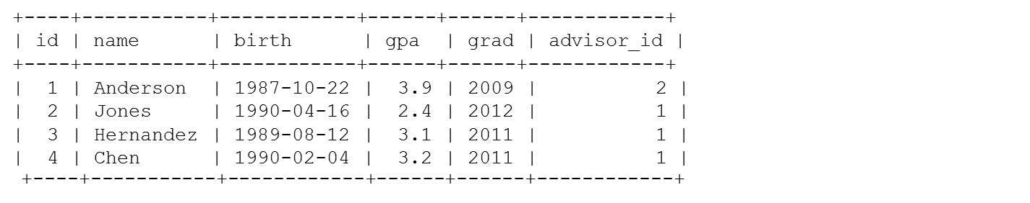
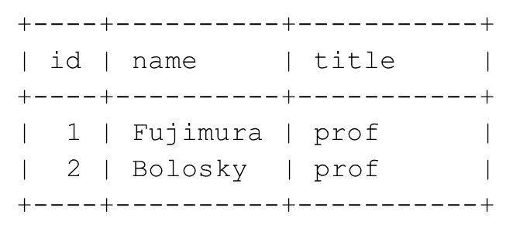
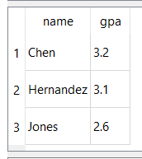
Join example: many-to-one relationship
Add a new column advisor_id to the students table. This is a foreign key.
ALTER TABLE students ADD advisor_id INTEGER;
UPDATE students SET advisor_id = 2 WHERE id = 1;
UPDATE students SET advisor_id = 1 WHERE id = 2;
UPDATE students SET advisor_id = 1 WHERE id = 3;
UPDATE students SET advisor_id = 1 WHERE id = 4;
Perform the join query: Get the students who are advised by Fujimura
SELECT s.name, s.gpa FROM students s, advisors a WHERE a.name = 'Fujimura' AND a.id = s.advisor_id;

Slide 23
many-to-many relationship implemented indirectly
Create a “join table” courses_students describing which students took which courses.
Courses: students take many courses, courses have many students
Add a new table describing courses:
+-----------+------------+
| course_id | student_id |
+-----------+------------+
+----+--------+-----------------+-------------+
| id | number | name | quarter |
+----+--------+-----------------+-------------+
| | 1 | | | 1 | |
| | 3 | | | 1 | |
| | 4 | | | 1 | |
| | 1 | | | 2 | |
| | 2 | | | 2 | |
| | 1 | | | 3 | |
| | 2 | | | 4 | |
| | 4 | | | 4 | |
|
|
|
|
1 | CS142
2 | ART101
3 | ART101
4 | PE204
| Web stuff
| Finger painting
| Finger painting
| Mud wrestling
| Winter 2009 |
| Fall 2008 |
| Winter 2009 |
| Winter 2009 |
+----+--------+-----------------+-------------+
+-----------+------------+

Slide 24
Exercise 2: many-to-many relationship
Find all students who took a particular course (‘ART101’):
Write the sql and execute it in db browser
+----------+-------------+
| name | quarter |
+----------+-------------+

Slide 25
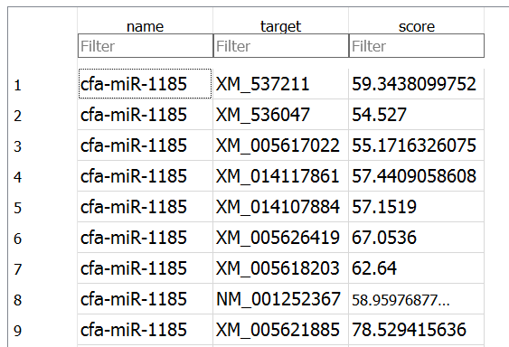
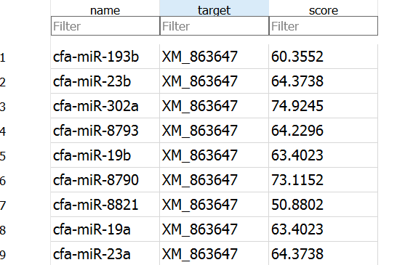
MicroRNA Prediction Database
What is microRNA?
A microRNA (miRNA) is a small non-coding RNA molecule (containing about 22 nucleotides) found in plants, animals and some viruses, that functions in RNA silencing and post-transcriptional regulation of gene expression.
miRDB is an online database for predicted microRNA targets in animals.
One miRNA can target many genes
One gene can be targeted by many miRNA

Slide 26
Create a database from mirdb data.
Download v6 in text file
http://mirdb.org/download.html, or from blackboard.
Create a sqlite database (named as mirdb_sqlite or anything you like) with a temp table
Go to file menu and select import table from csv file
Click on the mirDB_v6 and modify the table name
Change field 1 to name (the name of the microRNA)
Change field 2 to target (the ID of the gene)
Change field 3 to score (predicted scores, the higher, the more likely being targeted)

Slide 27
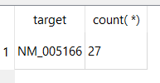
Exercise 3: mirdb database
How many miRNAs are predicted to target NM_005166
How many miRNAs are predicted to target NM_005166 and XM_539064
Use count() in SQL
How many predicted targets (genes) of hsa-let-7a-2-3p have a prediction score of at least 80?
Use count() in SQL
List the miRNAs and the number of their targets have a prediction score of at least 80 and group them by name. (Use count() and GROUP BY). Show only top 10 rows of the result.
(google if you don’t know)

Slide 28
Additional Database Features
Indexes: used to speed up searches
Concurrency: Allow more than one program use the database at the same time.
Transactions: used to group operations together to provide predictable behavior even when there are concurrent operations on the database.
Locks: Used to limit concurrent access.
Views: a virtual table for results of a stored
query
Procedures: a set of sql statements stored in the database

Slide 29
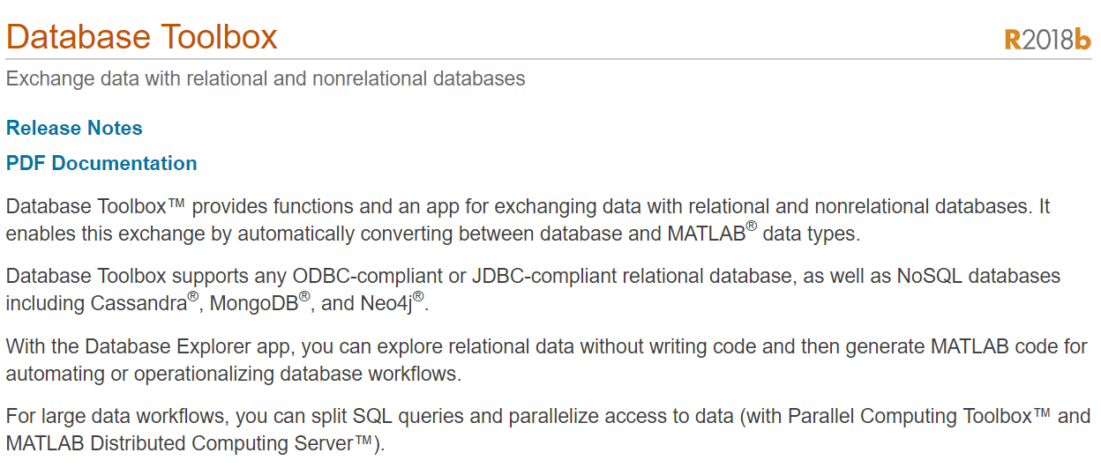
MATLAB Database Toolbox
https://www.mathworks.com/help/database/index.html

